Slide 1
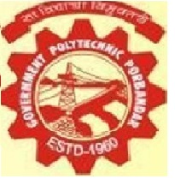

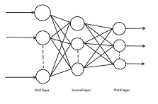
Project-II ( 3360707 )
Government Polytechnic, Porbandar
Group members
Nena Maitri V.
Naina Kuldip V.
Desai Riya J.
Sonegra Harsh B.
Guided By : Shri Kartik Detroja Sir.

Slide 2
Why we have selected this project. ?
There are many automations going on in the field of artificial intelligence in many international languages like English.
But it is not possible for every small regional languages of India due to unavailability of datasets, low resources and less importance of given by researchers.
So, as students of computer engineering we have selected a machine learning project to learn more about more advanced technologies and we have selected Gujarati handwriting recognition to support more automations in these regional languages of India.

Slide 3
Prerequisites of our project
Python and python libraries.
Linear algebra, Stats and Probability.
Data collection and analysis.
Data processing and pre-processing.
Flow and implementation of machine learning project.
Note: We have learnt all of prerequisites in our previous semester and implemented a cat vs dog project which is similar to our main project it contains classification, image processing etc..
Go to dog vs cat project

Slide 4
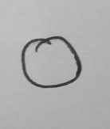

Implementation of our project –Dataset collection
We have collected handwritten dataset on paper.

Slide 5
Steps we have performed to get above results.
Cropping the images manually.
Resizing the images with python.
Gray scaling the images with python.
Absolute B/W filtering with python.
Image augmentation where images remain unequal for digits.

Slide 6
To feed it in our model.
We have converted the images into matrix.
Creating labels as a output prediction for each images.
Splitting the dataset as training and testing sub-sets.
Fitting the training data with our model.
Testing the loss and accuracy of model.
70-80% accuracy of our model by changing the parameters of our model.

Slide 7
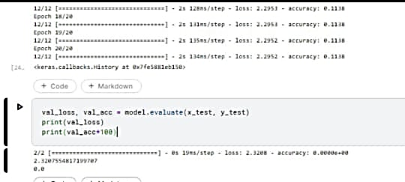
Challenges we have faced building the model.
Dataset collection and cropping of 1300 images.
Model under fitting due to small size of dataset and missing of absolute B/W filtering.

Slide 8
Future Scope
To apply alternative models to our dataset.
To provide a simple user interface to our model.
To enlarge size of dataset and add more Gujarati digits.

